Slide 1
Real Data Experimental Results
Distributed Monitoring
May 2019

Slide 2
Table of Contents
Entropy
AMS F₂
(TODO) Spectral Gap
(Requires data set) Inner Product

Slide 3
Research
Bandwidth Consumption
Distributed monitoring scheme
Data dimensionality
# Servers

Slide 4
Entropy

Slide 5
Data
Database accesses
https://www.kaggle.com/eyalgut/binary-traffic-matrices/version/2
4,702 users
11,654 database entries
1488 hours of usage
Goal: DDOS Anomaly detection

Slide 6
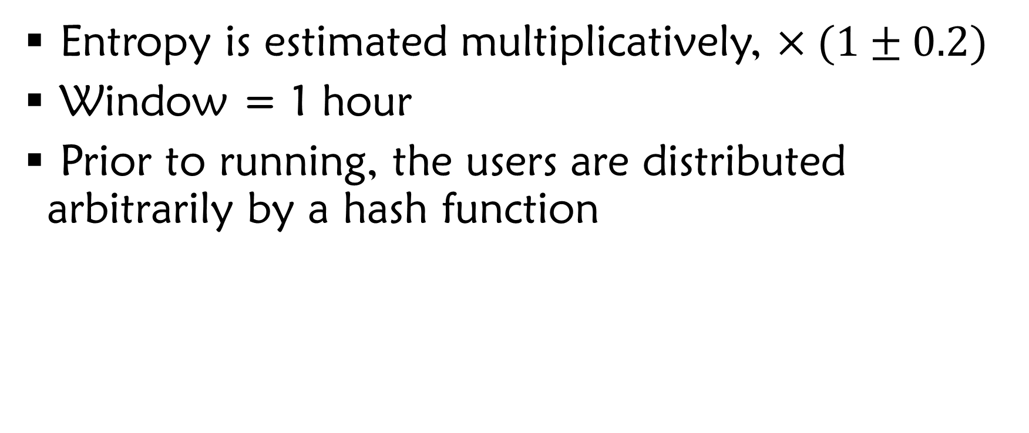
Running Details
Entropy is estimated multiplicatively, $×(1±0.2)$
Window = 1 hour
Prior to running, the users are distributed arbitrarily by a hash function

Slide 7
How the Data Looks
Entropy
Time

Slide 8
How the Data Looks, 2 servers
Entropy
Time

Slide 9
How the Data Looks, 2 servers
Entropy
First 200 hours
Time

Slide 10
How the Data Looks, 8 servers
Entropy
First 100 hours
Time

Slide 11
8 servers, Bandwidth / time
Bandwidth
time

Slide 12
Bandwidth / # nodes
Bandwidth
# nodes

Slide 13
Problem
Global entropy changes too fast
Real threshold crossings occur too often
Naïve solution suffices

Slide 14
Solution
Increase window size
Data changes will be smoother

Slide 15
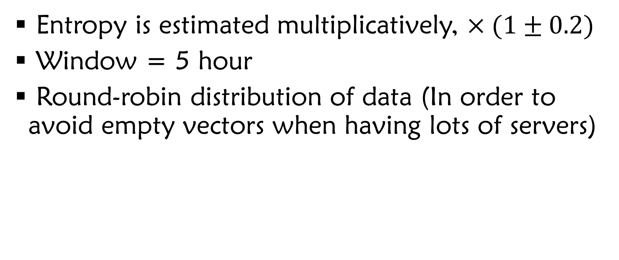
Running Details
Entropy is estimated multiplicatively, $×(1±0.2)$
Window = 5 hour
Round-robin distribution of data (In order to avoid empty vectors when having lots of servers)

Slide 16
TODO
Entropy results here on a larger |window|

Slide 17
AMS F₂

Slide 18
Synthetic Data
Random increased data, when only one server changes.
4 Servers
Data is captured until the fourth full sync of the Oracle

Slide 19
How the Data Looks
AMS Value
Time

Slide 20
Width = 70, Height = 71
Bandwidth
Time

Slide 21
Width = 70, Height = 71
Bandwidth
Time

Slide 22
Bandwidth / |vector|
Bandwidth
|vector|

Slide 23
(Bandwidth / Oracle Bandwidth) / |vector|
Bandwidth
|vector|

Slide 24
Real Data
Database accesses
https://www.kaggle.com/eyalgut/binary-traffic-matrices/version/2
4,702 users
11,654 database entries
1488 hours of usage
Goal: DDOS Anomaly detection

Slide 25
Data – Round Robin
AMS Value
First 160 hours
|Window| = 1
Time

Slide 26
Data – Round Robin
AMS Value
First 160 hours
|Window| = 1
Time

Slide 27
Data – Users Hashing
AMS Value
First 160 hours
|Window| = 1
Time

Slide 28
Data – Users Hashing
AMS Value
First 160 hours
|Window| = 1
Time

Slide 29
Results
Unfortunately, naïve scheme is better

Slide 30
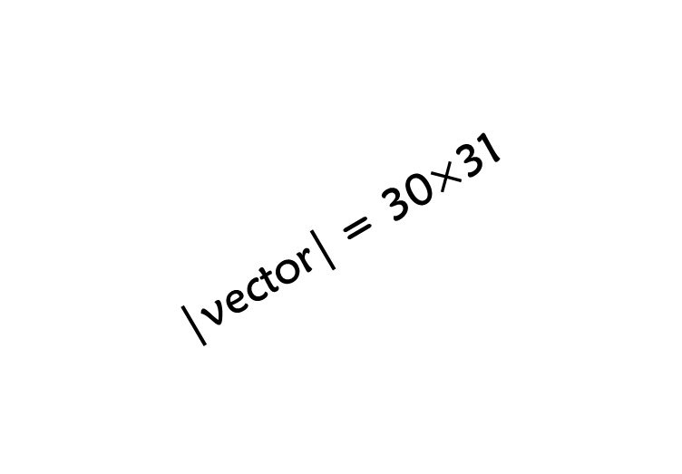
Bandwidth, |window|=1
Bandwidth
|vector| = 30$×$31
Time

Slide 31
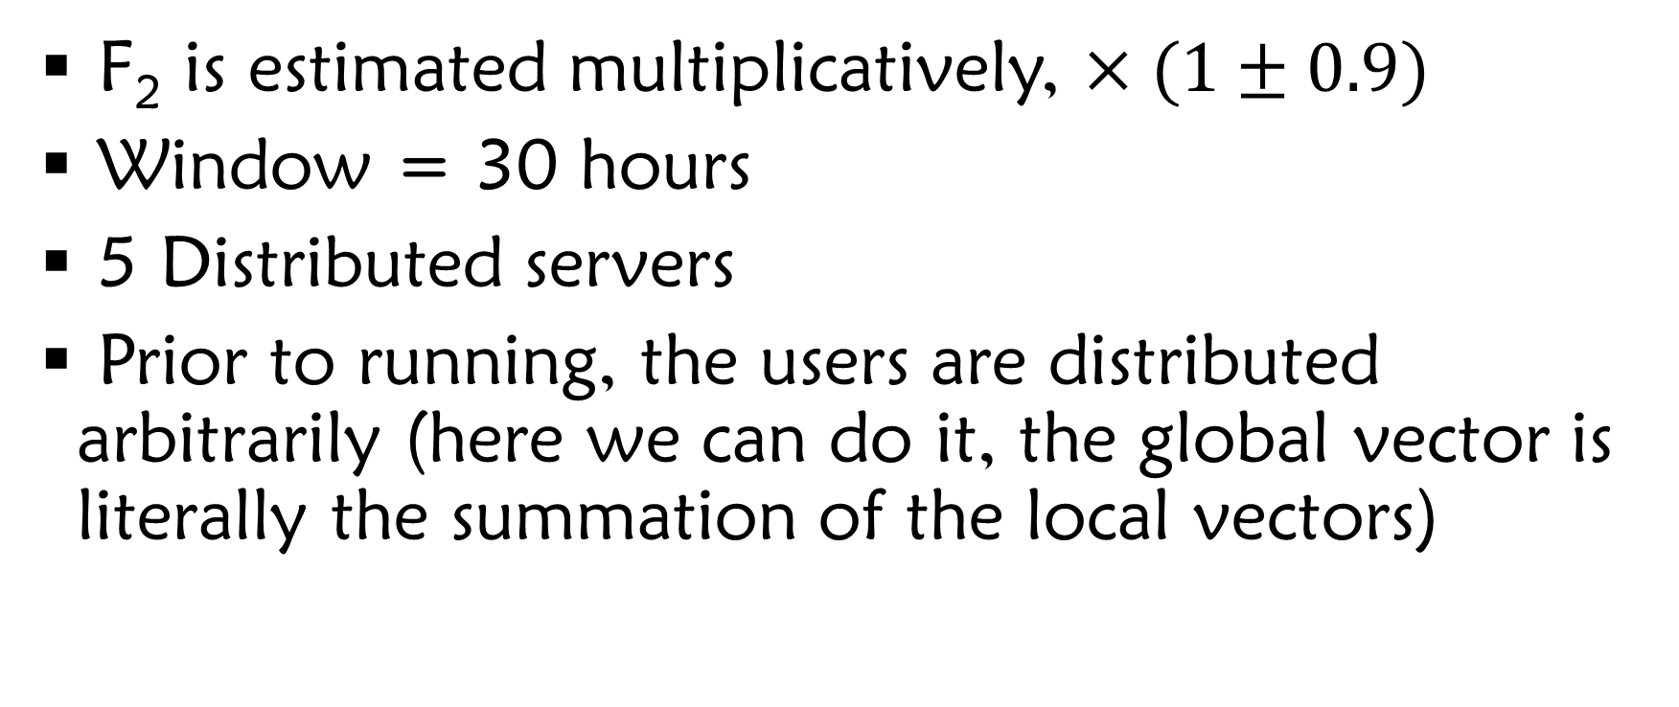
Running Details
F₂ is estimated multiplicatively, $×(1±0.9)$
Window = 30 hours
5 Distributed servers
Prior to running, the users are distributed arbitrarily (here we can do it, the global vector is literally the summation of the local vectors)

Slide 32
How the Data Looks
AMS Value
First 100 hours
Time

Slide 33
Bandwidth / |vector|
Bandwidth
|vector|

Slide 34
Spectral Gap

Slide 35
TODO

Slide 36
Inner Product

Slide 37
TODO

